Slide 1

Identify root components of website below

Slide 2
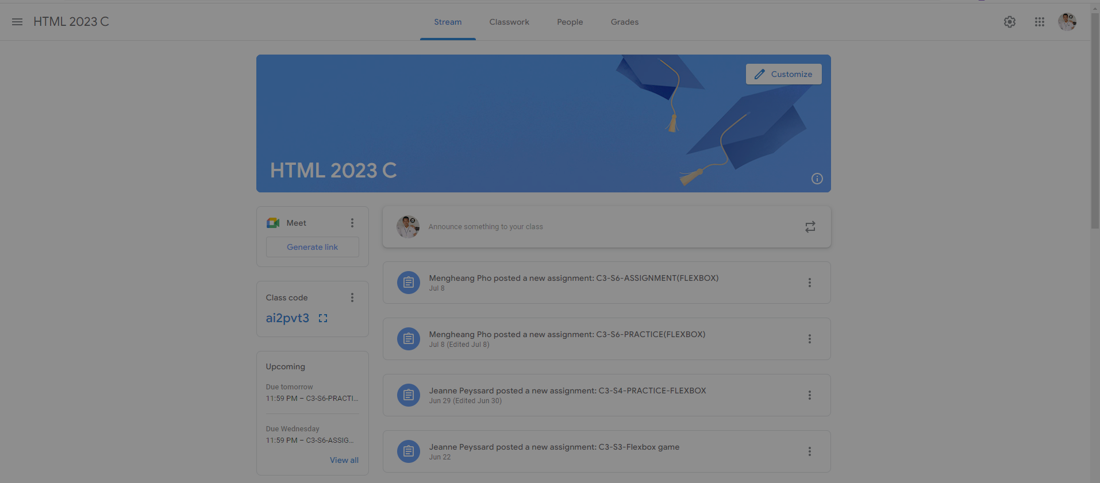
Flow-Direction: Column
Flex:0 Header
Flex:1 Main

Slide 3
Flow-Direction: Row
Flex:1 Leftside
Flex:0 Center
Flex:1 Rightside

Slide 4
Flow-Direction: Column
Flex:0 Banner
Flex:1 Content

Slide 5
Flow-Direction: Column
Flex:0
Summary
Flex:1 Messages

Slide 6
Flow-Direction: Column
Flex:0 Send-Message
Flex:1 Past-Messages

